Slide 1
Standard Cells Do Matter: Uncovering Hidden Connections for High-Quality Macro Placement
DATE 2024

Slide 2
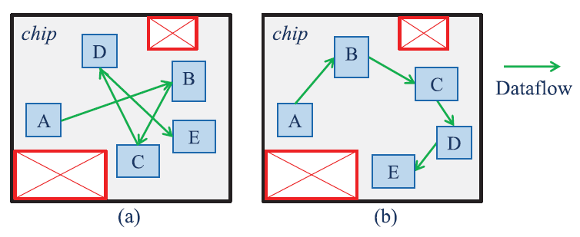
Introduction
Dataflow defines the moving of data between the macros and standard cells and influences the timing and power consumption of the circuit.
By minimizing the data movement, the placement of macros can reduce the overall design cost, as it reduces the routing process complexity eventually.

Slide 3
Introduction
Though Reinforcement Learning (RL) or Deep Learning (DL)-based methods such as [1]–[4] have been proposed to offer benefit of automating the macro placement actions, they incurred legalization problems, huge computational, and the training design dataset is not easy to access.
Dataflow-aware macro placers [5]–[10], where the dataflow is analyzed and used as constraints for further placement of the macros.

Slide 4
Introduction
In [5], optimized data path layout was generated by utilizing rule information directly extracted from dataflow graphs.
The approach in [7] considered dataflow and utilized the corner stitching data structure to address the problem of preplaced macros, which cannot be handled by simulated annealing (SA).
A recently released macro placer, RTL-MP [8], Hier-RTLMP[10] considered the macro-to-macro dataflow and proved that such dataflow is helpful in getting a human-quality layout.

Slide 5
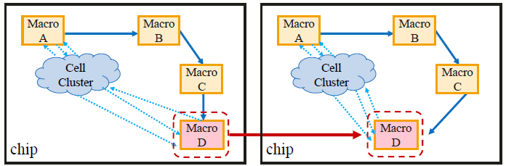
Introduction
Although the macro placers have been equipped with some forms of dataflow analysis capability, they mainly expose and utilize the macro-macro connections.
While an important fact is that standard cells are usually placed in clusters based on their hierarchy. If the cluster is large enough, it can be modeled as a “macro”. Thus the placement of standard cell clusters can in turn impact how macros are placed.

Slide 6
Introduction
Propose a novel methodology to comprehensively extract all direct and indirect dataflow connections among macro clusters and cell clusters, and use them as an important guidance for macro placement.

Slide 7
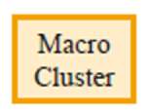

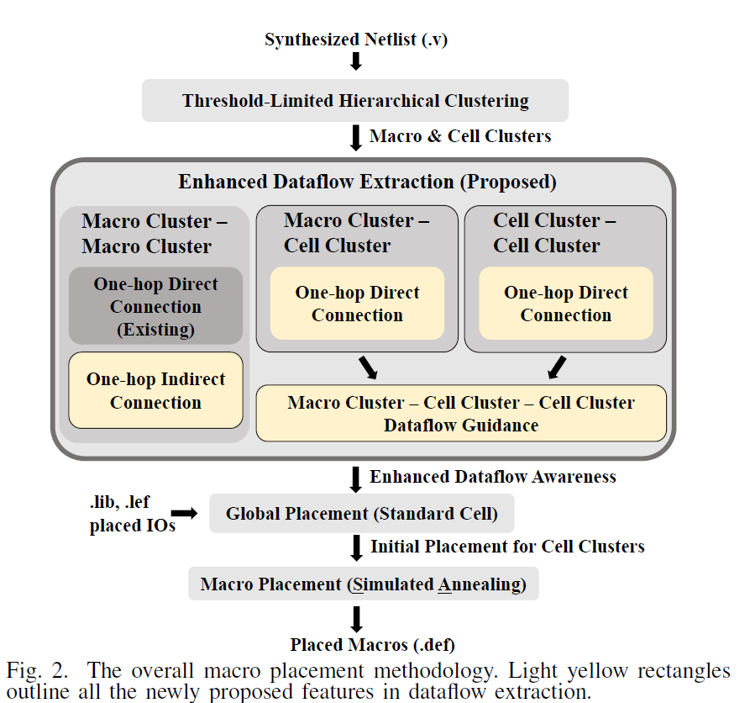
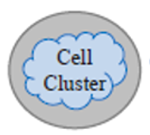
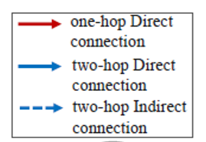
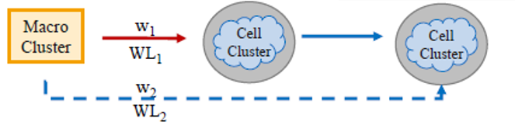
Methodology
1.
2.
1.
2.
3.
3.

Slide 8
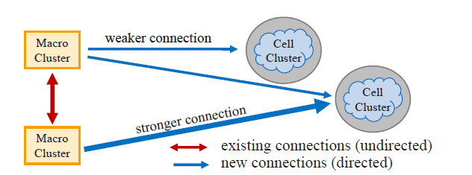
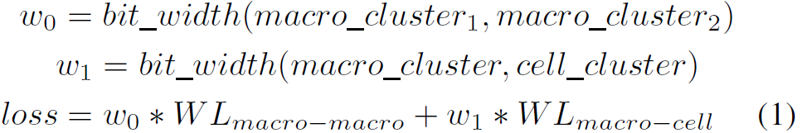
Dataflow Connection Extraction

Slide 9
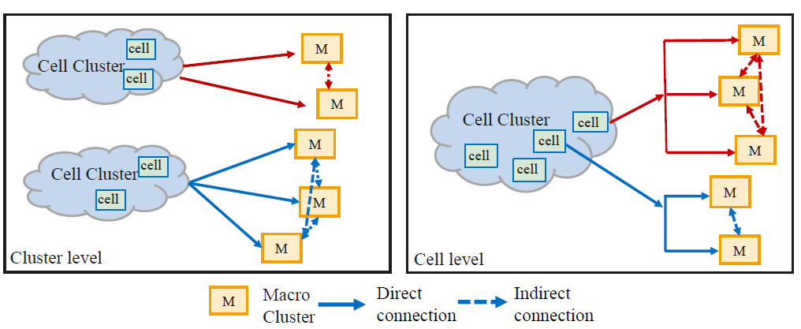
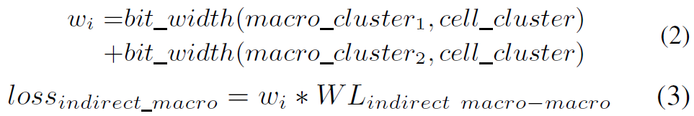
Dataflow Connection Extraction

Slide 10
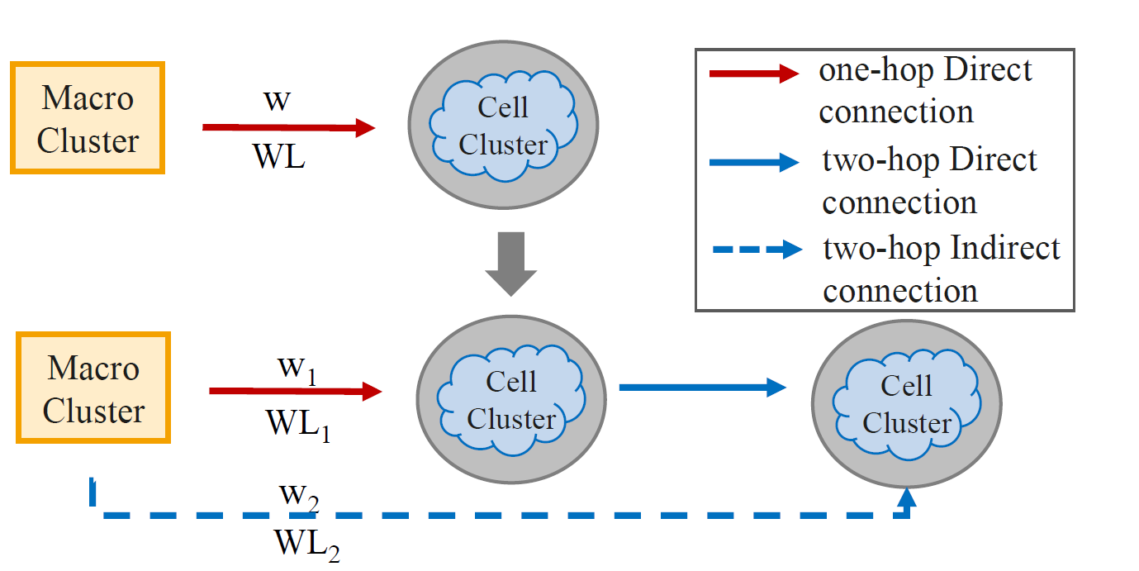
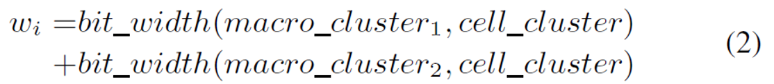

Dataflow Connection Extraction

Slide 11
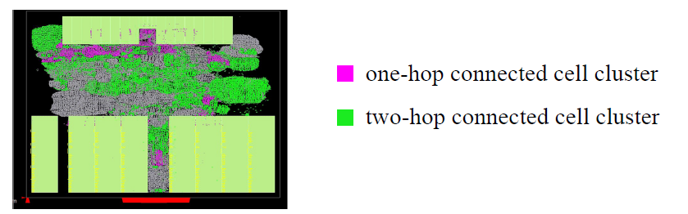
Dataflow Connection Extraction

Slide 12
Experiment Results
The netlist is obtained by running synthesis with Yosys [19].
We conduct extensive experiments and select seven benchmark designs from published literature or newly released test suites OpenROAD [18], [20].

Slide 13
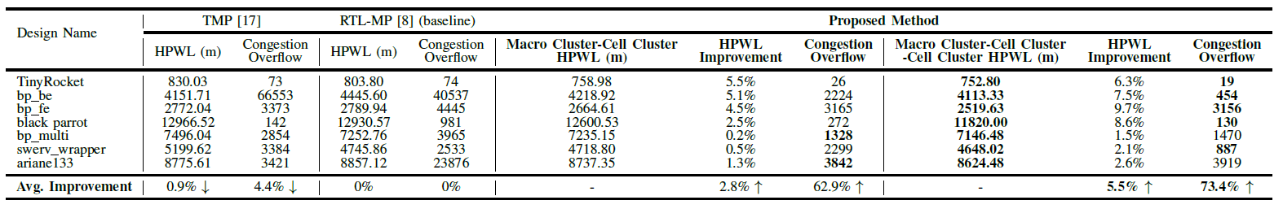
Experiment Results

Slide 14
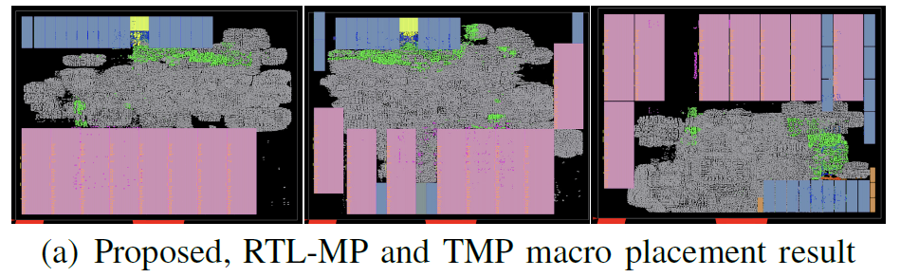

Slide 15
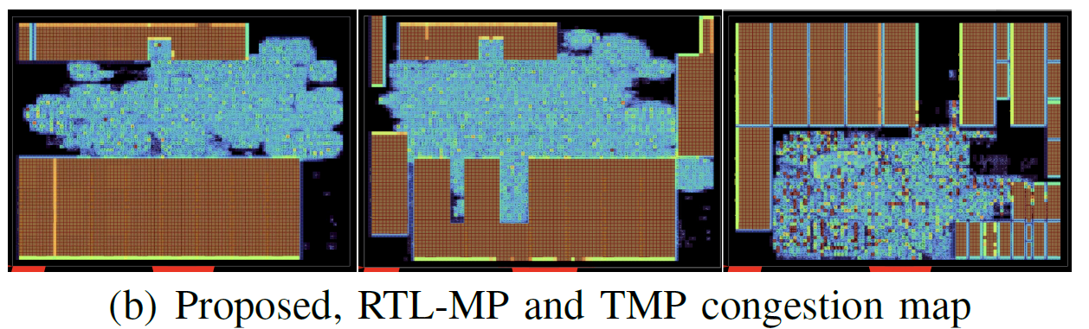

Slide 16
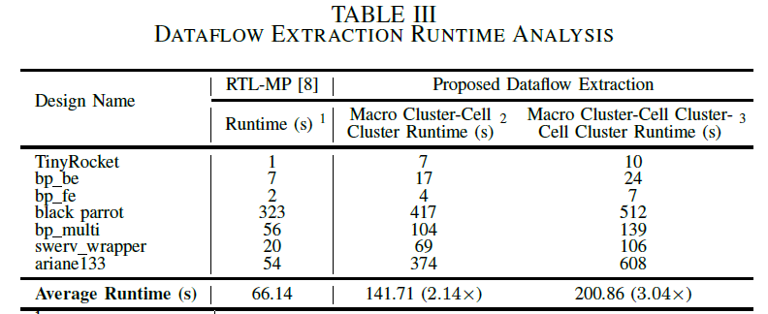
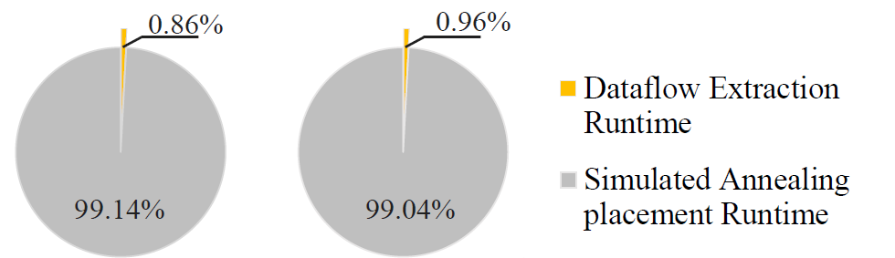

Slide 17
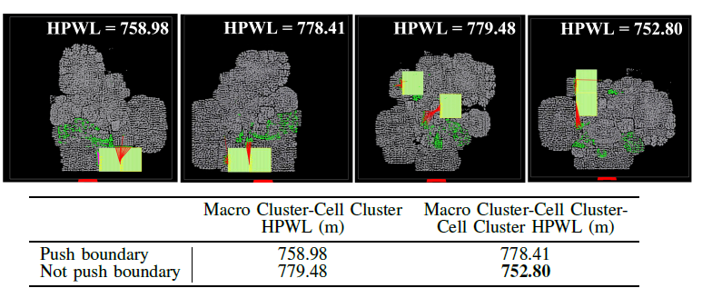
The Impact of “Push Boundary” Action

